Slide 1
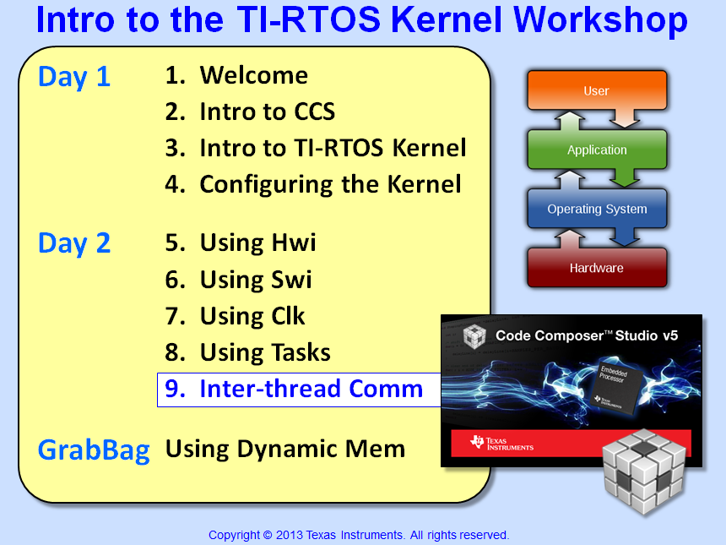

Slide 2
Objectives
Describe HOW to share resources between threads
Compare different use cases (concurrent access vs. producer/consumer model)
Analyze several BIOS building blocks for data sharing and signaling
Identify where semaphores can be a good choice vs. where they produce problems
Lab – Using Mailboxes and Queues

Slide 3
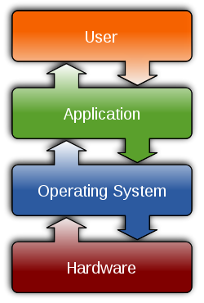
Outline
Overview of the Problem
Resource Sharing - Intro
“Producer-Consumer” Model
“Concurrent Access” Model
Same Priority Threads
Lab

Slide 4
Sharing Data Between Threads - Problem
What are common ways that threads share resources?
Thread A
Data
Thread B
Just use Globals and don’t worry about it !!
Come on, mutex’s are better. They are easy and we use them all the time. They cause no problems.
What problems can occur when using globals/mutex’s?
Well, since we’re in the SYS/BIOS workshop, there must be some services this RTOS provides to help us…
Yes, BIOS can help...but let's first look at the types of "sharing" that are possible...
Notes:
The problem with globals is that a thread might get pre-empted and cause contention for the resource. This is explained later. The problem with mutex’s is that they can cause priority inversion. Again, this is covered later. The point here is to get the students thinking about the problems we’re trying to solve FIRST, then we’ll look at the solutions…

Slide 5
Outline
Overview of the Problem
Resource Sharing - Intro
“Producer-Consumer” Model
“Concurrent Access” Model
Same Priority Threads
Lab

Slide 6
Resource Sharing – Two Types
“Producer – Consumer” Model
Thread A
Thread B
Msg
BIOS “Container”
Thread A produces a buffer or Msg and places it in a container.
Thread B blocks until available, then consumes it when signaled (no contention)
Data communication is achieved using BIOS “containers” (objects)
“Concurrent Access” Model
Resource = Data or Peripheral
Resource
Thread A
Thread B
Any thread could access “Resource” at any time (no structured protocol/container)
Pre-emption of one thread by another can cause contention or priority inversion
Let's look at the producer-consumer model first...

Slide 7
Outline
Overview of the Problem
Resource Sharing - Intro
“Producer-Consumer” Model
Using Queues
Using Mailboxes
“Concurrent Access” Model
Same Priority Threads
Lab

Slide 8
Producer – Consumer Model – Intro
Thread A
Thread B
Msg
produce
consume
BIOS “Container”
How it Works:
Data is UNIDIRECTIONAL – one thread waits for the other to produce
Thread B often BLOCKS until data is produced
Advantages:
Both threads use same protocol – contention is often avoided
Threads become more “modular” and therefore reuse improves
Examples:
BIOS: Queue, Mailbox, Stream I/O
May have built-in synchronization or user can add signaling via Semaphores and Events

Slide 9
Outline
Overview of the Problem
Resource Sharing - Intro
“Producer-Consumer” Model
Using Queues
Using Mailboxes
“Concurrent Access” Model
Same Priority Threads
Lab

Slide 10
Queue Concepts…
Thread A
put
Msg1
Msg2
Msg3
get
Thread B
Queue
A Queue is a BIOS object that can contain anything you like
“Data” is called a “Msg” – simply a structure defined by the user
Msgs are “reclaimed” on a FIFO basis
Key APIs:
Advantages: simple, not copy based
Disadvantage: no signaling built in
Queue_put();
Queue_get();
How would you synchronize the writer and reader?
Notes:
The QUE structure inherits QUE_Elem and adds a payload – this is how BIOS extends definitions throughout.
When you do a QUE_put, this changes the next/prev ptrs and places Msg in QUE.
Easy to extend to 3,4,5, etc buffers.

Slide 11

Synchronizing Queues…
Thread A
put
Msg1
Msg2
Msg3
get
Thread B
Queue
Use a Semaphore to synchronize writer/reader:
TALKER
LISTENER
Queue_put(&myQ, msg);
msg = Queue_get(&myQ);
Semaphore_pend(&Sem, -1);
Semaphore_post(&Sem);
Note: “Queue+Sem” is the basis for how “streams” are built to interface with I/O drivers – e.g. Platform Support Package (PSP) drivers from TI.
Let's see how Queues are used in a system...
Notes:
If you Queue_get() an EMPTY queue, you get back the handle to the Queue_Obj (something to test for…maybe)

Slide 12

Using Queues in a System…
User Setup:
Declare Queue in CFG
Define (typedef) structure of Msg
Fill in the Msg – i.e. define “elements”
Send/receive data from the queue
struct myMsg {
Queue_Elem elem;
short *pInBuf;
short *pOutBuf;
} Msg;
Example – RCV side of peripheral driver (Hwi):
Double Buffer System – main init puts TWO Msgs in toHwiQ
Hwi gets EMPTY Buffer from toHwiQ (and fills it up with data)
main
put
put
Hwi puts FULL Buffer into toTSKQ (gets next EMPTY)
Task gets FULL buffer from toTSKQ (process)
1
Task puts EMPTY buffer into toHwiQ
get
Hwi
put
2
toHwiQ
5
put
Task
get
Note: two Queues allow Msgs to circulate between threads.
toHwi = EMPTY, toTSK =FULL
3
toTSKQ
4
Notes:
Note – the Queue object doesn’t really contain anything. When puts and gets are performed, the Queue_Elem pointers (next/prev) get updated everywhere. This is why a queue is able to expand and contract to any size. The fxn that creates the message owns the memory – the receiver simply gets a pointer to that memory – so it is not copy-based.

Slide 13
Outline
Overview of the Problem
Resource Sharing - Intro
“Producer-Consumer” Model
Using Queues
Using Mailboxes
“Concurrent Access” Model
Same Priority Threads
Lab

Slide 14
Using Mailboxes
Thread A
post
Msg1
Msg2
Msg3
pend
Thread B
Mailbox
Mailboxes – a fixed-size BIOS Object that can contain anything you like
Fixed length defined by:
Number of Msgs (length of mailbox)
Message Size (MAUs)
Key APIs (both can block):
Mailbox_post (&Mbx, &Msg, timeout); // blocks if full
Mailbox_pend (&Mbx, &Mail, timeout); // blocks if empty
Advantages: simple FIFO, easy to use, contains built-in semaphore for signaling
Disadvantage: copy-based (both reader/writer own a copy) – best if used to pass pointers or small Msgs
Notes:
Writing semaphore init’d to mailbox length. Reading semaphore count init’d to zero. Post blocks on full mailbox. Pend blocks on empty.

Slide 15
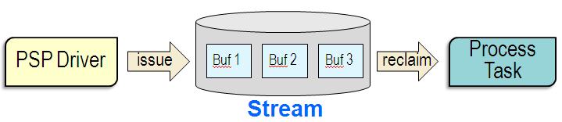
Advanced “Producer-Consumer” Services
More advanced versions of the “producer-consumer” model are built into SYS/BIOS and other drivers/frameworks:
Platform Support Package (PSP) Drivers
Issue/Reclaim buffers to/from a STREAM (input and output Queues)
Messaging between cores (DSP → DSP, ARM → DSP)
Lowest layer uses BIOS MessageQ
SysLink is a layer above MessageQ – a driver ported to Linux and SYS/BIOS
SysLink/IPC
MessageQ

Slide 16
Outline
Overview of the Problem
Resource Sharing - Intro
“Producer-Consumer” Model
“Concurrent Access” Model
Using Globals
Modify Scheduler
Using MUTEXs
Using Priority Mutex Gates
Deadlock
Same Priority Threads
Lab

Slide 17
“Concurrent Access” Model – Intro
Data
Thread A
Thread B
How it Works:
Data is “up for grabs” – often first-come, first-serve
User must add “protection” to avoid contention between different PRI threads
Advantages:
Common usage – many systems use MUTEXs for resource protection
Disadvantages:
MUTEXs can cause priority inversion or deadlock – both ugly scenarios
Modifying scheduler behavior (e.g. disabling INTs) can cause jitter in the system
Examples:
BIOS: Scheduler Mgmt, MUTEX (Gates), Task_setPri
Note: watch out for “globals” accessed by multiple threads w/no protection…
Let's first look at a simple use of globals...

Slide 18
Outline
Overview of the Problem
Resource Sharing - Intro
“Producer-Consumer” Model
“Concurrent Access” Model
Using Globals
Modify Scheduler
Using MUTEXs
Using Priority Mutex Gates
Deadlock
Same Priority Threads
Lab

Slide 19
What’s Wrong With Using Globals ??
If two threads share a global, what’s the problem?
Thread A (hi)
Thread B (lo)
void A (void) {
…
cnt += 1;
}
void B (void) {
…
cnt += 1;
}
LD
ADD
ST
What happens if Thread B gets pre-empted by A?
The assembly code underneath does LD, ADD, ST…
B could store the wrong value…
Let’s look at a definition of “critical section” first…
Notes:
There are MANY methods. The rest of the chapter talks about each one and their pluses/minuses
The two most COMMON are Mutex and disabling Hwi’s

Slide 20
Critical Resource Protection
Some sort of PROTECTION mechanism has to be used to protect threads from conflict when sharing a resource
In simple terms, let’s define CRITICAL SECTION as the time when the SHARED RESOURCE is being accessed:
Enter
Exit
Thread
CRITICAL SECTION
For example, if a Task and Hwi are sharing a resource, the GATE, or Enter/Exit commands in the Task might be:
Enter (Global INT = OFF)
Exit (Global INT = ON)
Task
CRITICAL SECTION
MUTEXs, between Tasks, could also be used during Enter/Exit
What forms of “protection” exist?
Notes:
There are MANY methods. The rest of the chapter talks about each one and their pluses/minuses
The two most COMMON are Mutex and disabling Hwi’s

Slide 21
Outline
Overview of the Problem
Resource Sharing - Intro
“Producer-Consumer” Model
“Concurrent Access” Model
Using Globals
Modify Scheduler
Using MUTEXs
Using Priority Mutex Gates
Deadlock
Same Priority Threads
Lab

Slide 22
Modifying BIOS Scheduler Behavior
“When in doubt, just turn off interrupts !”
This might sound funny…but it is a common method to solve contention problems in systems
Modifying the scheduler’s behavior is the ONLY solution for Hwi/Swi:
Usage (Notice Enter/Exit gates)
Hwi_disable(); turn off global INTs
Hwi_restore(); restore global INTs
Swi_disable(); turn off all Swi’s
Swi_restore(); restore Swi’s
Task_disable(); turn off all Tasks
Task_restore(); restore Tasks
Task_setPri(); Set Task Pri
void B (void)
{ . . .
pGIE = Hwi_disable();
cnt += 1; //critical
Hwi_restore(pGIE);
. . .
}
Advantages: common, simple
Disadv: can cause jitter, latency
Let’s move on to MUTEXs…
Notes:
Jitter in the system. I would suggest users use these methods as a LAST RESORT. Start by designing IN the use of queues and mailboxes … then, if absolutely necessary…then ok…maybe this is a necessary bandaide….

Slide 23
Outline
Overview of the Problem
Resource Sharing - Intro
“Producer-Consumer” Model
“Concurrent Access” Model
Using Globals
Modify Scheduler
Using MUTEXs
Using Priority Mutex Gates
Deadlock
Same Priority Threads
Lab

Slide 24
Data Sharing Using Semaphores
Data
Thread A
Thread B
MUTEX = Mutually Exclusive (only one thread at a time)
Mutex is commonly used in systems to protect a critical resource being accessed by multiple threads
Users can create a mutex using semaphores with an initial count of 1
Task Hi
Task Low
Semaphore_pend(Sem);
Semaphore_post(Sem);
Semaphore_pend(Sem);
Semaphore_post(Sem);
Semaphore: Sem
Initial Count = 1
D
D
Advantages: common, simple, can use FIFO or Priority Sems
Disadvantage: no “ownership”, possible “nested” calls, another thread could inadvertently post the Sem again
Mutex Gates solve these problems…

Slide 25
GateMutex Usage
enter
leave
TSK Hi
block
access
enter
leave
TSK Lo
access
block
access
Use the following code in BOTH (TSK Hi and TSK Lo)
gateKey = GateMutex_enter(gateMutex); // enter Gate
cnt += 1; // protected access
GateMutex_leave(gateMutex, gateKey); // exit Gate
TSK Lo has “key” (non-zero if first to enter gate). TSK Hi blocks at “enter”. When TSK Lo finishes access, TSK Hi can access shared resource.
MUTEXs can cause priority inversion…
Notes:
gateMutex is a GATE OBJECT created in the app.cfg file. It is unique between threads that share a gate. The gateKey can be used by an app to know if it is the FIRST one to enter (non-zero).

Slide 26
Priority Inversion
enter
TSK Hi
Blocked for a LONG time…
TSK Med
enter
TSK Lo
access
access
TSK Lo enters critical section (using Semaphores or Gates)
TSK Hi pre-empts, but blocks to let TSK Lo leave critical section
TSK Med pre-empts TSK Lo and holds off TSK Hi indefinitely
How could we use Task_setPri() to help us ?
Notes:
When TSK Med’s enter into the picture – this is the definition of priority inversion. Otherwise, TSK Lo getting the “gate” or “Sem” is ok and the way you would want it to work.

Slide 27
Temporarily Elevate Priority – Task_setPri()
Hwi
INT!
TSK Hi
Ready
Running (data access) !!
Enter - setPri(Hi)
Exit - setPri(Lo)
TSK Lo
data access
pre-empted
TSK Lo can elevate its priority just before data access and then lower its priority just after data access using:
Advantage: no semaphore/mutex required !!
Task_setPri();
Mutex Priority Gates can come in handy for situations like this…
Notes:
Can use Task_setPri to temporarily raise the priority of the lower thread to the higher just before data access (discussed next). User can also use GateMutexPri which does the same thing…but is easier to use. Alas, if the threads are at the same priority, NONE of this crap happens….

Slide 28
Outline
Overview of the Problem
Resource Sharing - Intro
“Producer-Consumer” Model
“Concurrent Access” Model
Using Globals
Modify Scheduler
Using MUTEXs
Using Priority Mutex Gates
Deadlock
Same Priority Threads
Lab

Slide 29
Priority Mutex Gates
INT!
enter
leave
TSK Hi
run
block
access
enter
leave
Lo inherits
Hi’s Pri
TSK Lo
access
pre-empted
pre-empted
access
Use the following code in BOTH (TSK Hi and TSK Lo)
gateKey = GateMutexPri_enter(gateMutexPri); // enter Gate
cnt += 1; // protected access
GateMutexPri_leave(gateMutexPri, gateKey); // exit Gate
TSK Lo inherits priority of TSK Hi if TSK Hi requests resource access (enter) and then returns to original Pri after “leave”.
Advantages: simple to code, does automatic Task_setPri() of TSK Lo
Deadlock...
Notes:
gateMutexPri is a GATE OBJECT created in the app.cfg file. It is unique between threads that share a gate. The gateKey can be used by an app to know if it is the FIRST one to enter (non-zero).

Slide 30
Outline
Overview of the Problem
Resource Sharing - Intro
“Producer-Consumer” Model
“Concurrent Access” Model
Using Globals
Modify Scheduler
Using MUTEXs
Using Priority Mutex Gates
Deadlock
Same Priority Threads
Lab

Slide 31
How DEADLOCK Can Occur…
Data
Thread A
Thread B
Data
Deadlock occurs when two threads block each other (stalemate)
Conditions for deadlock include:
Use of MUTEX with multiple resources (with circular pending)
Threads at different priorities
Task A
Task B
Solutions:
Sem_pend(res_1);
// use resource1
STUCK ?
Sem_pend(res_2);
// use resource2
Sem_post(res_1);
Sem_post(res_2);
Sem_pend(res_2);
// use resource2
STUCK ?
Sem_pend(res_1);
// use resource1
Sem_post(res_2);
Sem_post(res_1);
Use timeouts on _pend
Use same ordering in both threads – 1, 2, 3
Lock one resource at a time, or ALL of them

Slide 32
Outline
Overview of the Problem
Resource Sharing - Intro
“Producer-Consumer” Model
“Concurrent Access” Model
Same Priority Threads
Lab

Slide 33
Threads At SAME Priority
Data
Thread A
Thread B
Pri = X
Pri = X
Can threads at the SAME priority pre-empt each other? NO !
So, it is a good idea to place threads that share a critical resource AT THE SAME PRIORITY. Life is good…
Advantages galore:
Built-in FIFO scheduling (no pre-emption or scheduler mods)
No signaling required (no Semaphore, no blocking)
Less memory/time overhead for pre-emption (context switch)
No corruption or contention – easy to maintain
VERY simple – solves ALL types of critical resource sharing problems (e.g. priority inversion and deadlock)
Note: watch out for “Murphy” if someone changes priorities !

Slide 34
Outline
Overview of the Problem
Resource Sharing - Intro
“Producer-Consumer” Model
“Concurrent Access” Model
Same Priority Threads
Lab

Slide 35

Labs 5-9 “Roadmap”
Lab | Trigger | Hwi | Other | Fxn
5 | h/w timer | BIOS Hwi ledToggle
5B | BIOS timer ledToggle (Hwi)
6 | h/w timer | BIOS Hwi | BIOS Swi ledToggle
7 | BIOS Clock ledToggle (Hwi, Swi)
8 | h/w timer | BIOS Hwi | BIOS Task ledToggle
9 | h/w timer | BIOS Hwi | LED State → Mbx/Que →ledToggle

Slide 36

Lab 9 – “Blink LED” Using Mailbox & Queue
Lab Goal:
The state of the LED (on or off) will now be passed by Message (via a Mailbox or Queue).
Procedure
Import archived (.zip) project (starter code)
Add Mailbox object + post/pend (for LED on/off)
Build, “Play”, Debug
Add Queue object + put/get (for LED on/off)
Build, Run, Debug
main.c
main() {
init_hw();
Timer (500ms)
BIOS_start();
}
Time: 45 min
Scheduler
Hwi
Semaphore_post(Sem);
Hwi ISR
Task
mailbox_queue(){
Post LED State to Mbx/Queue; }
mailbox_queue()
Mailbox or Queue
Task
ledToggle(){
PEND on read from Mbx/Queue;
Toggle LED based on LED State;
}
ledToggle()
Idle

Slide 37


Slide 38
Chapter Quiz
Name the two basic data sharing models and solutions for each:
Compare and contrast mailboxes and queues:
Which fxn calls are commonly used to modify scheduler behavior?
What problems can occur when using MUTEX’s. What is the sol’n?
Which sol’n guarantees no conflicts between threads sharing data?

Slide 39
Chapter Quiz
Name the two basic data sharing models and solutions for each:
Compare and contrast mailboxes and queues:
Which fxn calls are commonly used to modify scheduler behavior?
What problems can occur when using MUTEX’s. What is the sol’n?
Which sol’n guarantees no conflicts between threads sharing data?
Producer-Consumer: Queues, Mailboxes, Stream I/O, Sem/Event
Concurrent Access: Scheduler Mgmt, Gates, Mutexes, SAME PRI
Mailbox – fixed length, copy based, signaling built-in, simple use
Queues – anything you like, not copy based, no signal, flexible
Hwi_disable/restore(); or MOD_disable/restore
Priority Inversion, Task_setPri(); or GateMutexPri_enter/leave
Place threads that share data AT THE SAME PRIORITY

Slide 40
Outline
MainHighlight
MainNormal
SubHighlight
SubNormal

